Slide 1
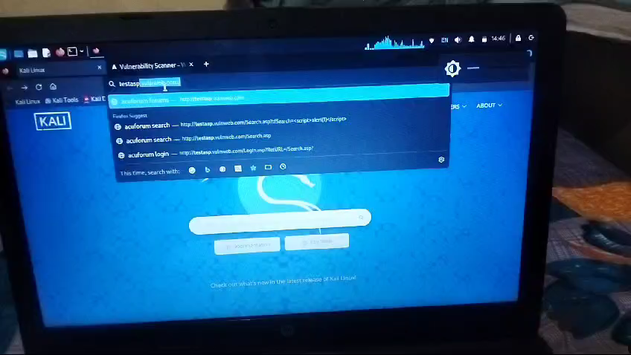

Slide 2
REPORT WRITING
Title: Found Cross Site Scripting
Domain: Vulnweb.com
Subdomain: testasp.vulnweb.com
Steps to Reproduce:
Visit http://testasp.vulnweb.com
Click on the Search Tab.
Now click on search bar.
Try Cross Site Scripting.<script>alert(1)</script>
Successful find cross site scripting.
Prepare a report for it.
Impact: Cross Site Scripting can lead to stealing of your data and can be harmful to you.
Suggest to solve this vulnerability.
Mitigation: If you want to prevent your website to be vulnerable of XSS through search bar.
POC including video in the report which are given above.

